Slide 1
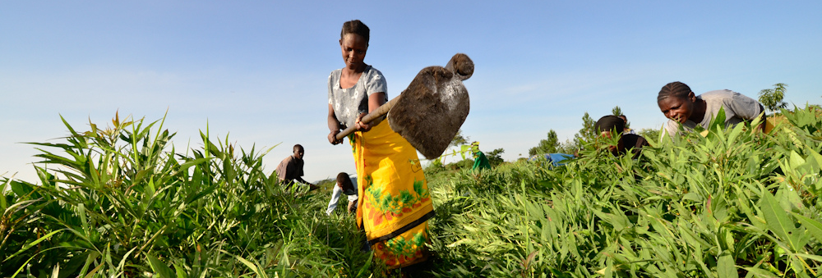
PHOTO TO BE REPLACED
AUGUST 2020
Climate Change
Mitigation in East Africa
Graham thiele • RTB Annual Meeting
Notes:
To change the cover photo in this template, right click and select “Change Picture…”

Slide 5
Thank you

