Slide 1
Effectiveness of cassava stem pruning for inducing delay in postharvest physiological deterioration (PPD) of fresh roots
By
Muyinza H., Nyakaisiki E., Matovu M., Nuwamanya F., Wanda K., Abass A., and Naziri D.

Slide 2
Introduction
Cassava (Manihot esculenta Crantz) is an important food for low-income populations
It is a staple food raw material for many value added products
Increasingly fresh root consumption is on the rise and projected to increase in Uganda
However postharvest losses on the crop are high and estimated at over 25% in Uganda.
Major cause of PH losses is PPD

Slide 3
Post-harvest physiological deterioration
PPD Manifests as blue-black vascular streaks in a ring along periphery/ sometimes vertically, off flavours and less palatable cassava products
It occurs within 48 hours of harvest caused by production of phenolic compounds (scopoletin) induced at harvest by mechanical damage
is the main cause of fresh cassava root losses

Slide 4
PPD……
Results in increased market rejects
Poor product yield and Market quality; Poor commercialisation possibilities
Significant economic losses (to farmers and retailers)
Enhanced shelf life would result in increased fresh root market access and incomes from fresh cassava sales and increased food security at HH level
Thus need for effective and affordable technologies that can ensure enhanced root shelf life and assure fresh root quality

Slide 5
Objectives of the study
To investigate the effect of cassava stem pruning on level of PPD of Ugandan cassava varieties
To evaluate the effect of Pruning when combined relative humidity storage on cassava root shelf life

Slide 6
Methodology
Leaves were removed from 10 mature plants of six varieties including; Nyaraboke, Bao, Mercury, NASE 14, Tim tim and Hoima using a sharp knive. Another set of 10 plants for each variety were left un-pruned
The plants were then left for 7 days
After one week, both pruned and un-pruned plants from all the varieties were harvested and taken to the lab for analysis. Roots were washed dipped in fungicide (Ridomil) + surfactant sufsilwet Gold100% in (1 ml/ litre) for 2 minutes
They were then analysed for PPD after 7 days
Another lot was treated similarly but the roots were stored in high relative humidity bags (hermetic bags) for the 7 days prior to assessment for PPD
Data was analysed using Excel

Slide 7
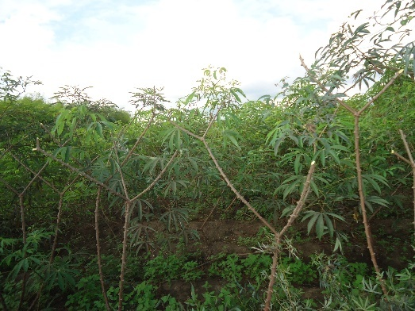
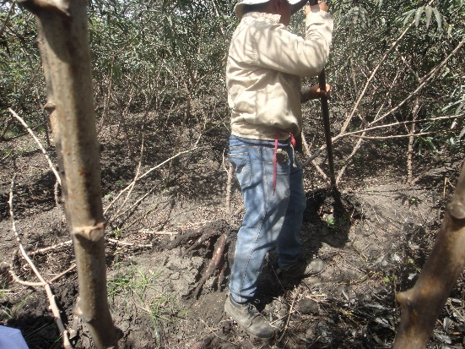
Pruning process and root harvesting

Slide 8
Root assessment

Slide 9
Scoring PPD
Proximal end of the treatment root s was cut and covered
7 slices were assessed for PPD per root
Numerical values are assigned according to a scale of 0 to 10 on the proximal surface of each cut.
The scale values correspond to 0%, 10% 20% 30% to 40% and so on corresponding to 10 up to 100% deterioration.

Slide 10
Results
There was significant reduction in PPD on pruned compared to un-pruned cassava roots of the same varieties
Pruning maintained root quality for over 7 days of cassava storage

Slide 11
Effect of pruning on PPD levels
% PPD

Slide 12
Results

Slide 13
PPD effect after 14 days

Slide 14
Effect of pruning + Relative humidity storage at 7 days

Slide 15
Results..
Thus pruning results in reduced PPD on cassava
The effect was enhanced when roots were stored at high relative humidity conditions resulting in zero loss
It resulted in increased sugar to starch ratio for -sweeter varieties
Increased root shelf life
Made roots more acceptable to consumers when tested up to 14 days of storage
No specific changes in other properties especially cyanide
These findings also those of confirm earlier studies on varieties in Latin America

Slide 16
Implications….
Pruning thus can increase general output of fresh root cassava business
Could result increased marketability of fresh roots especially at retail level
Reduces postharvest losses and waste thus can increase HH food security
Lowers cost of production

Slide 17
Conclusion
Pruning significantly reduced the rate of PPD in cassava
When combined with relative humidity storage can result in complete elimination of deterioration up to 2 weeks storage in some varieties
It can thus be used to reduce the high economic losses caused by PPD especially at retail level

Slide 18
Recommendations
More research to pilot this and other shelf life enhancing technologies needs to be done especially to pilot the technology at enterprise level
Cost benefit analyses need to be done to evaluate the technology especially when combined with other shelf-life enhancing options

Slide 19
Acknowledgements
RTB Endure Project
NARO
CIAT- Colombia Cassava Team
Organisers of the WCRTC

Slide 20
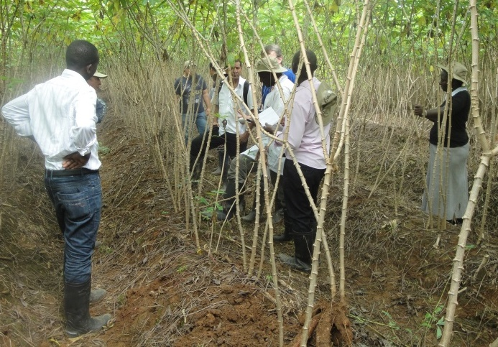
Si Shie

