Slide 1
The impact of PPD in the fresh cassava roots value chain and current mitigation measures in Uganda: Perspectives and actions of value chain actors
Kelly Wanda, Abass Adebayo, Alenkhe Bamidele, Harriet Muyinza, Moses Matovu, Ephraim Nuwamanya, Geoffrey Menya, Sharon Achieng, Pamela Nyamutoka, Robert Kaliisa and Peter Waigumba
EC/IFAD/RTB project RTB-ENDURE:
Expanding Utilization through Research
21/01/2016

Slide 2
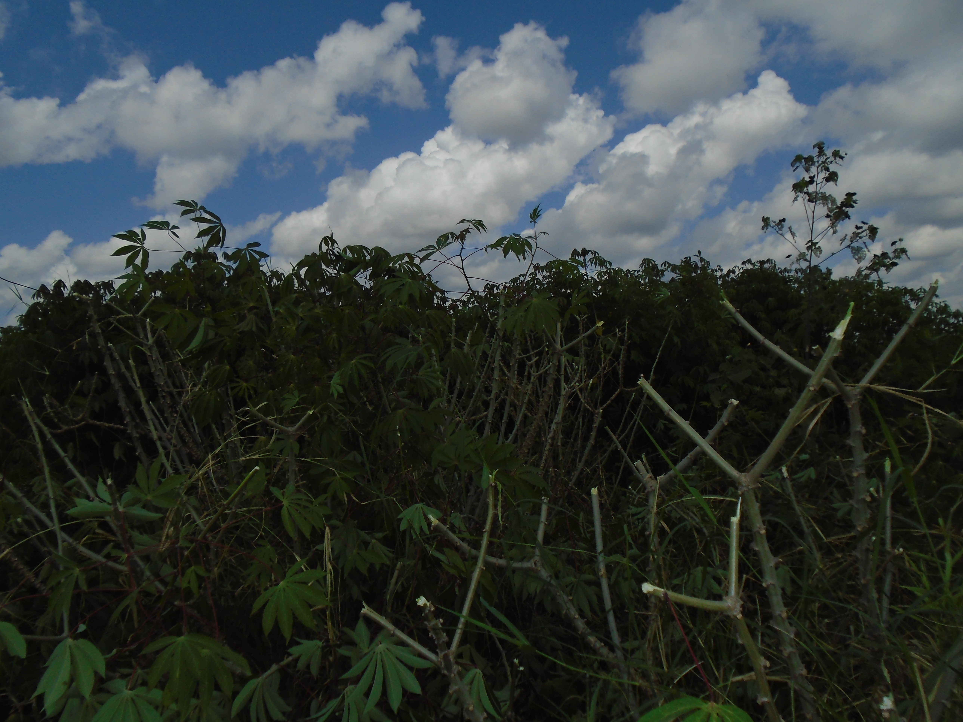
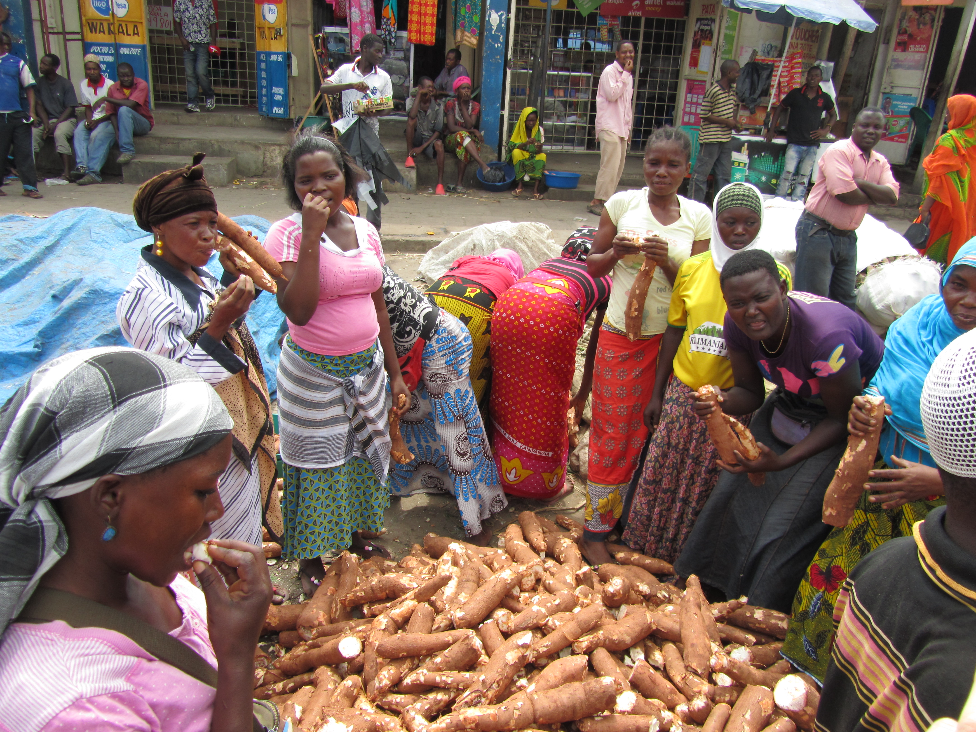
Introduction
Cassava = second most important staple
60% (grow); 90%(consume)(EAAPP, 2011)
Snack, main meal
DD increasing esp urban
Major employer to women & men, youths
About 90% new releases “sweet var”
New generation cash provider
“fast food” equivalent for esp mass mkt
1 of 10 priority crops for ASSP
1 of 4 crops with national platform
Potential limited by PPD

Slide 3
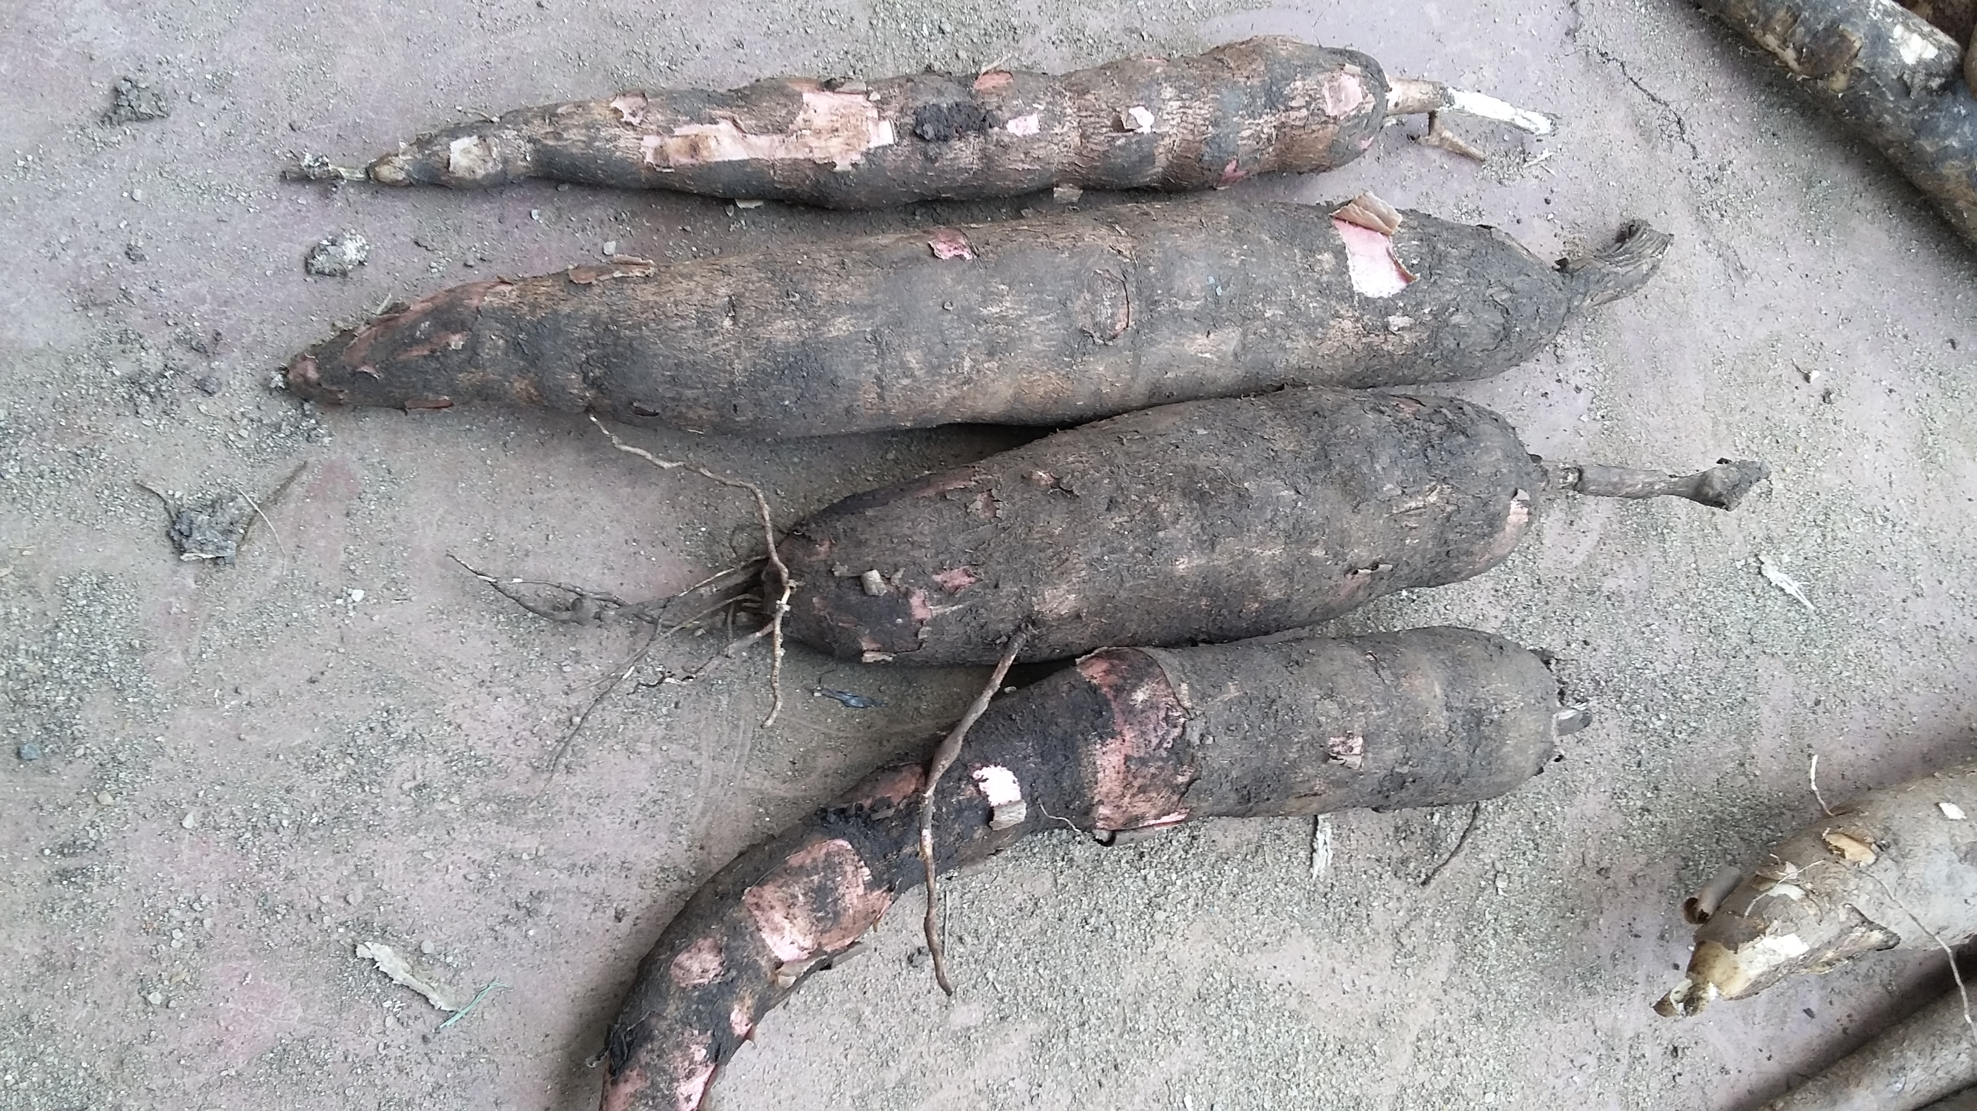
Introduction cont..
PPD research still limited in terms of impact, response in current dynamic markets
Need to further understand PPD issues in Uganda to provide and support demand driven solutions

Slide 4
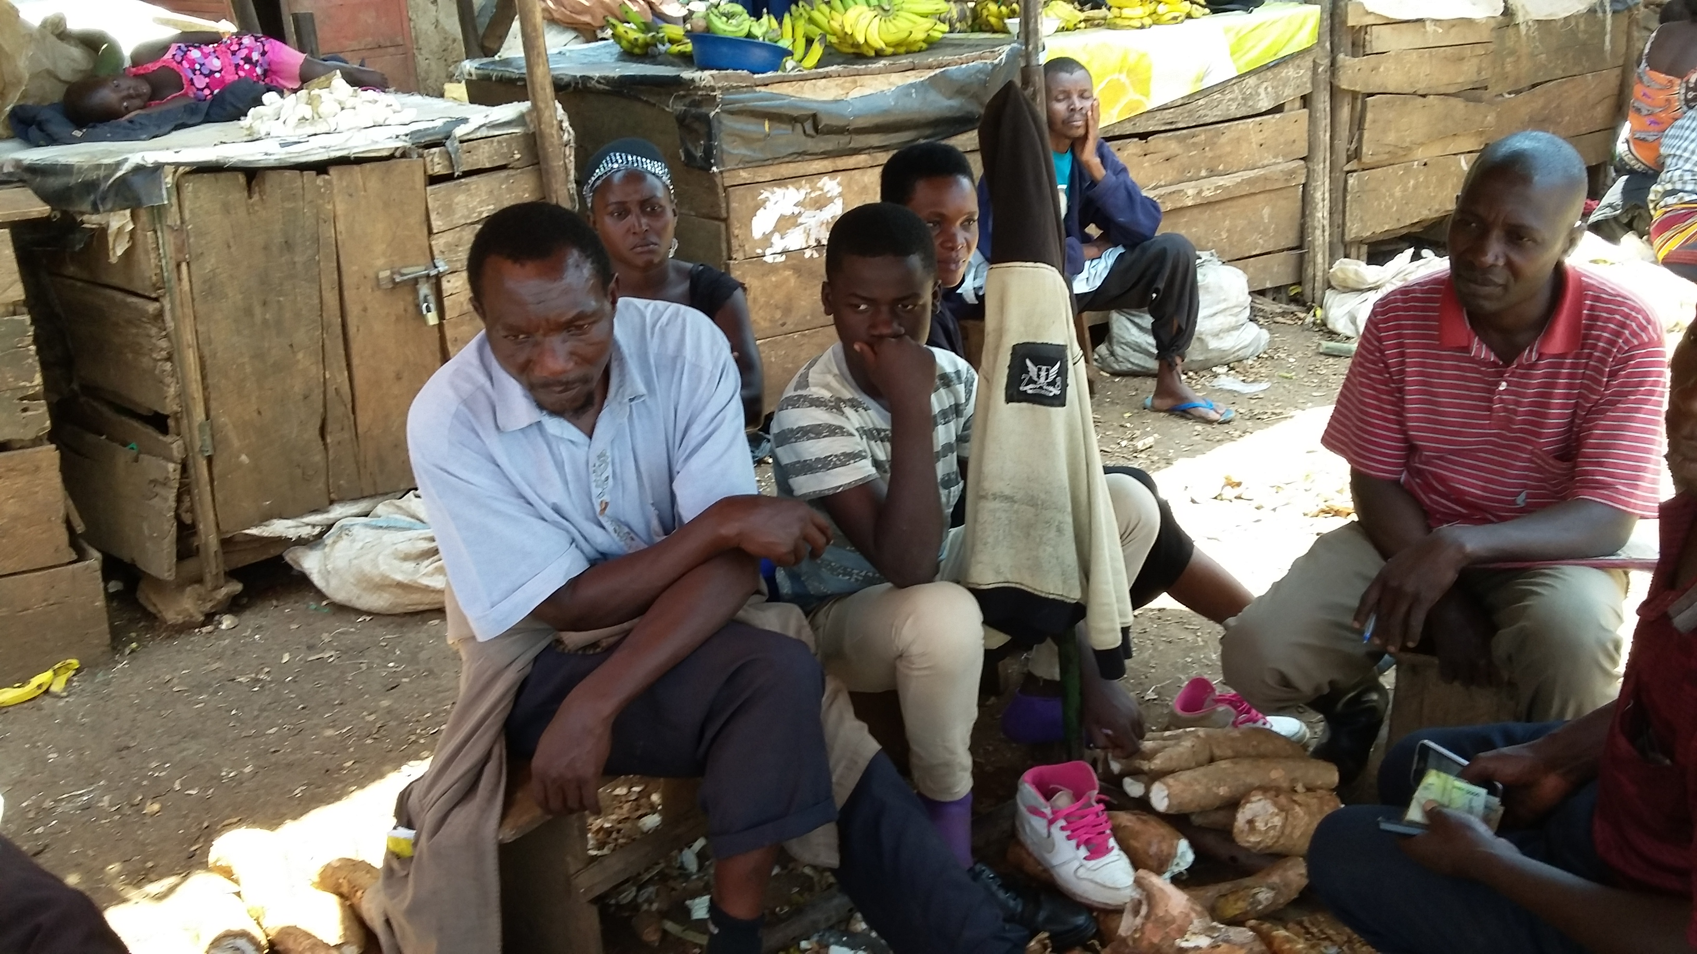
Materials and Methods
Approach Value chain
multi-stage sampling
purposive – 2 locations – why? Major supply points for FCR ( Masindi axis vs greater kabarole axis (kyegegwa/kyenjojo)
Stratified according to actor
Random within value chain nod
Desktop reviews
Interviews
Participatory market chain analysis
Observations along VC

Slide 5
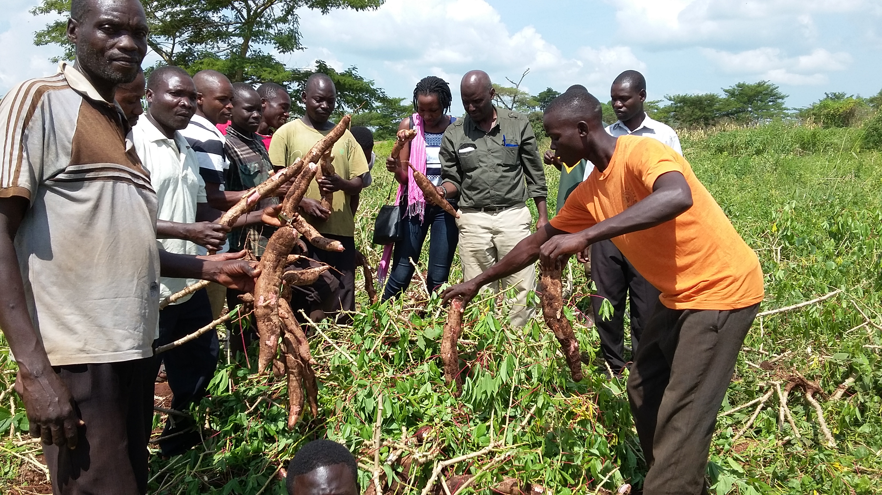
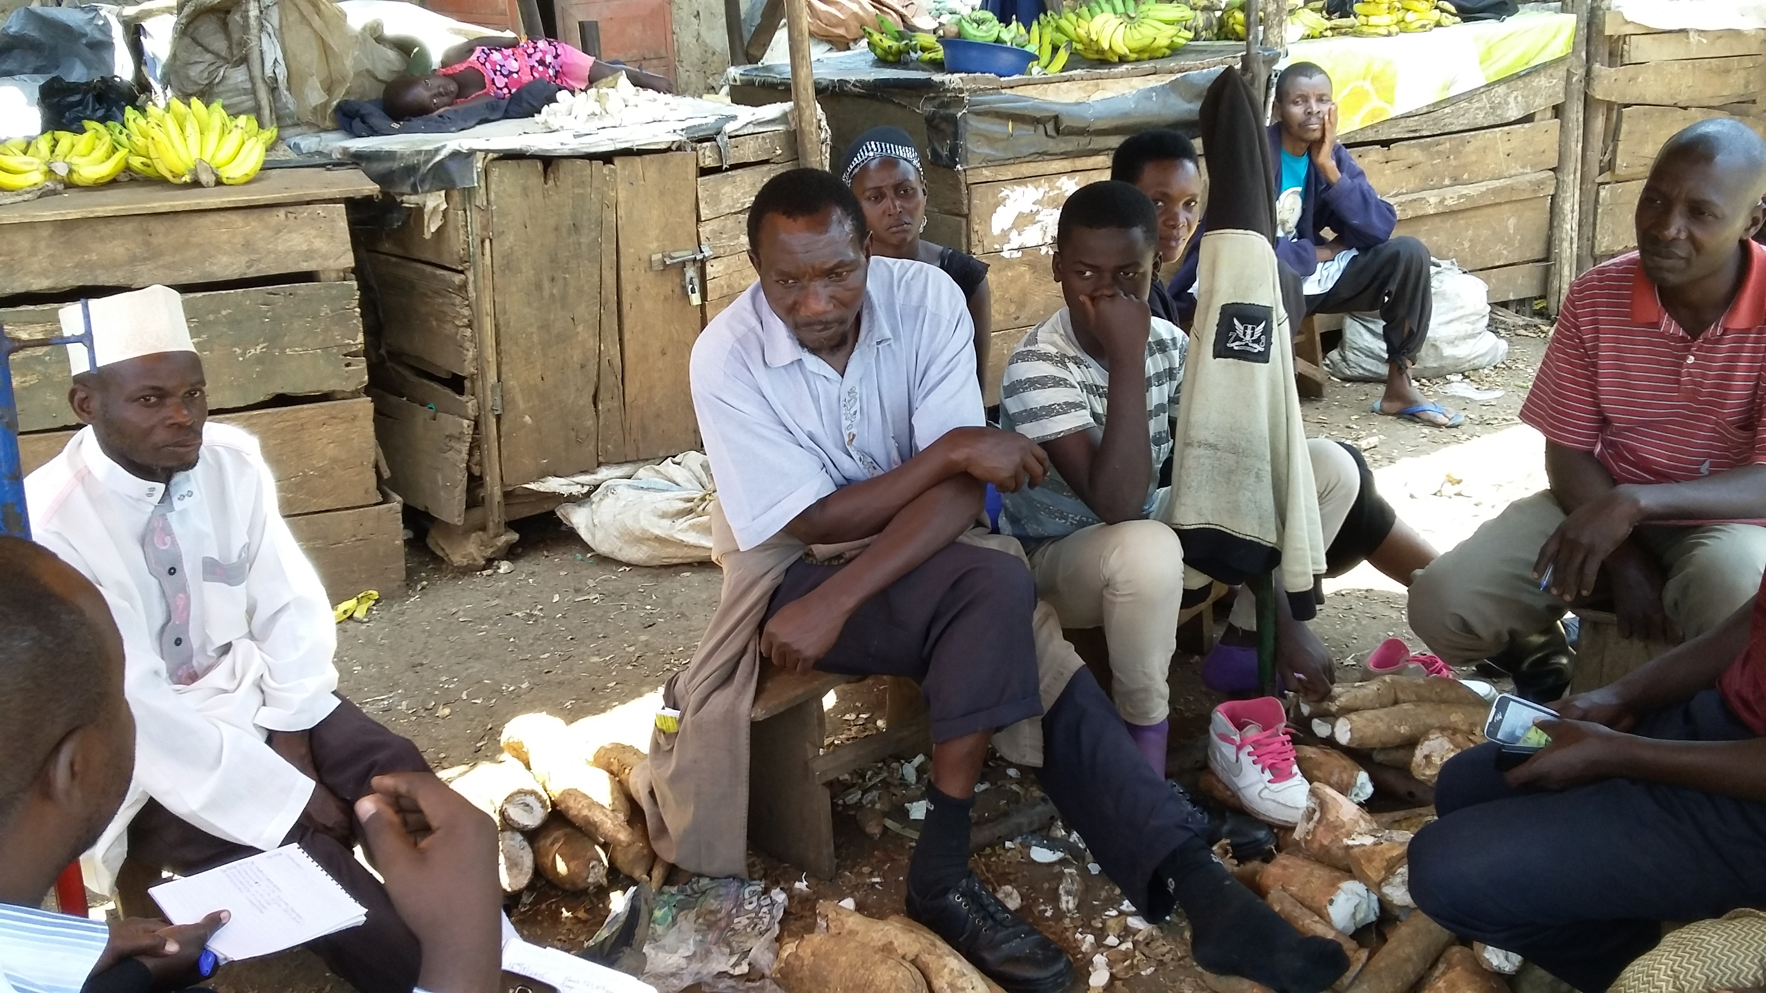
Materials and Methods cont...
sample size total = 309
Farmers = 105
Rural assemblers = 7
Wholesalers = 20
Retailers = 118
Consumers = 67
Spread btn supply points and major consumption location – mainly Kampala city

Slide 6
Results
general :
entire chain driven by PPD considerations
chains very efficient and fast to reduce losses
all actors affected but suffer diff ways
More visible and serious at retail level and consumer ( taste poor)

Slide 7
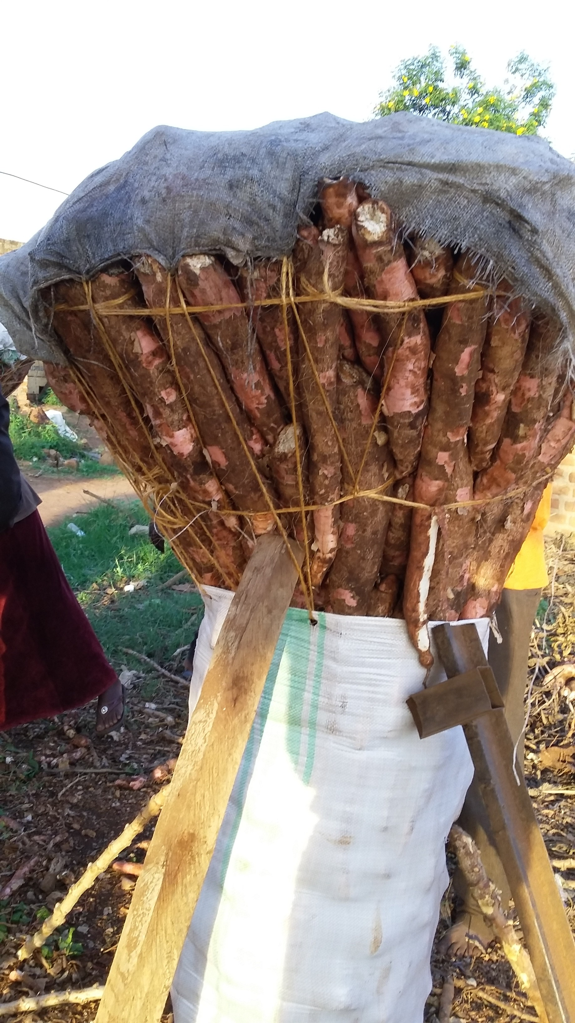
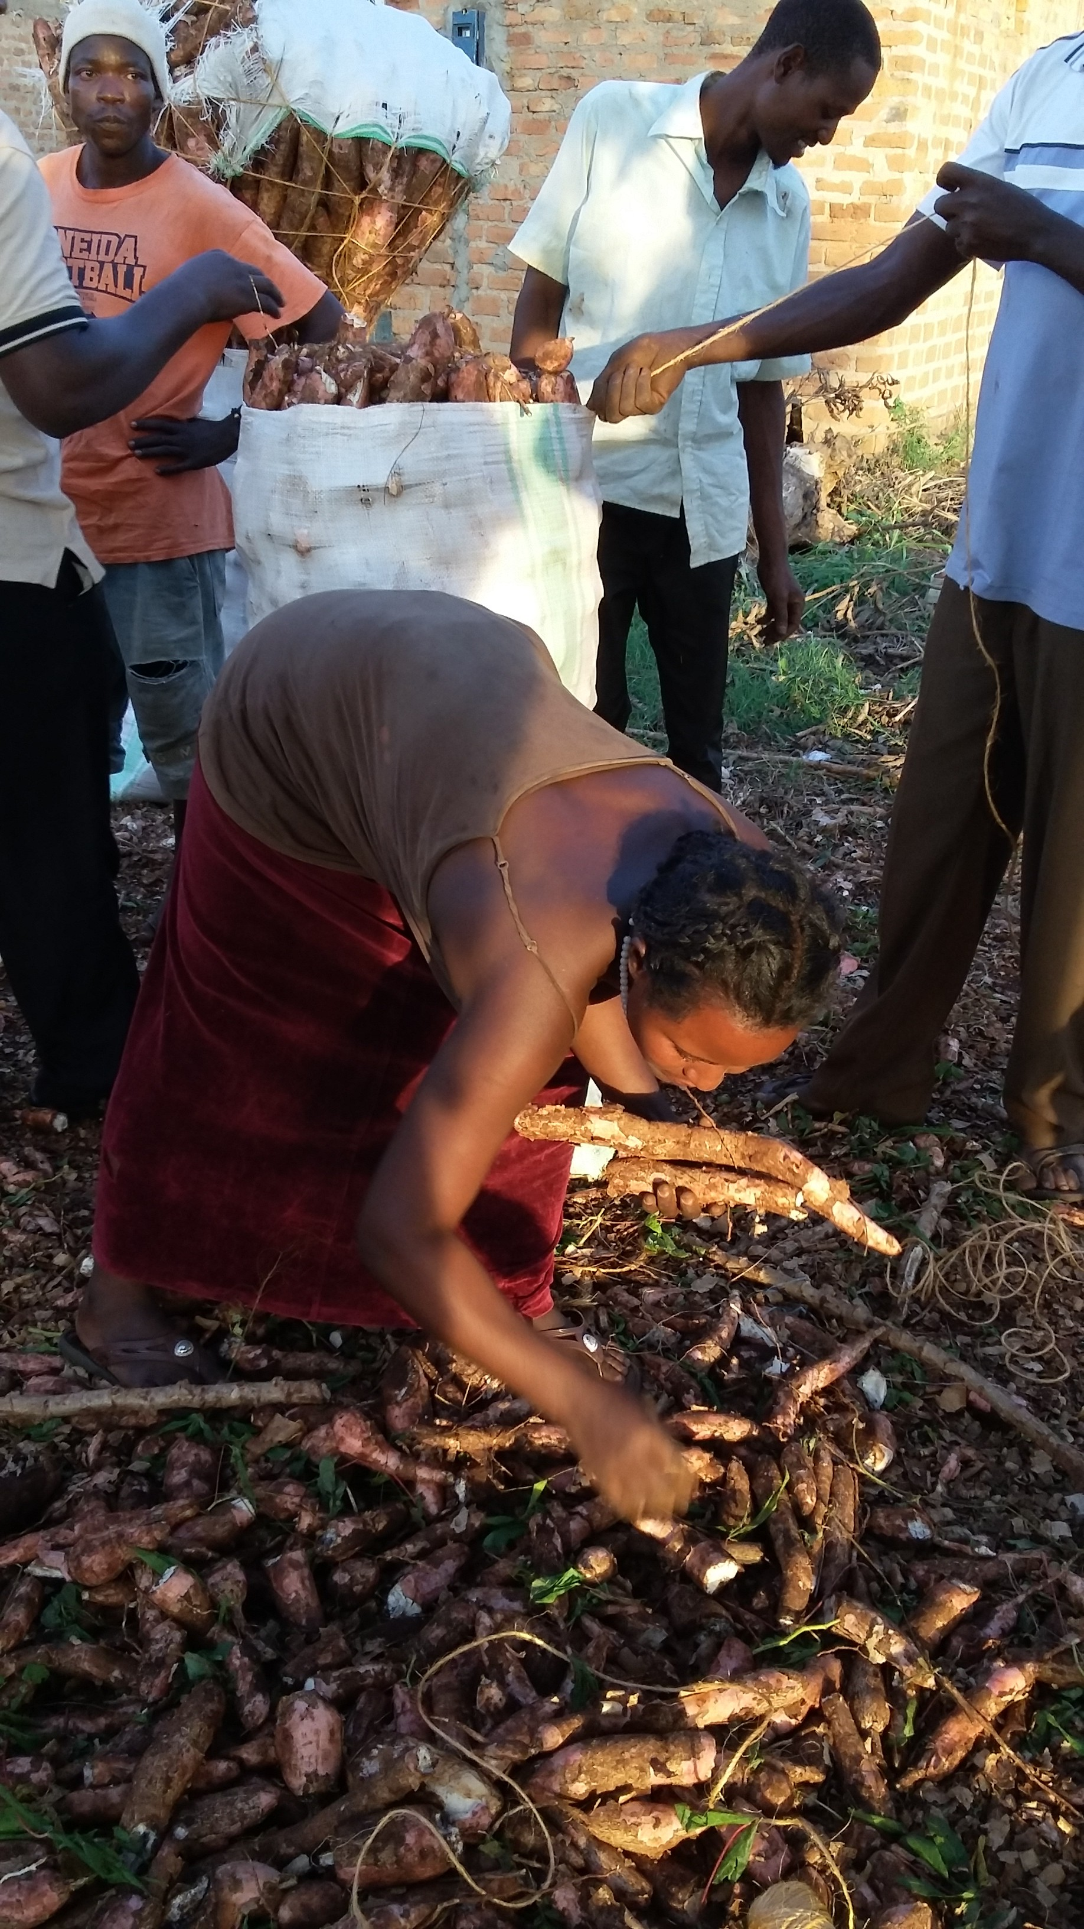
Results continued
Farmer level :
low bargaining power
Low prices ( double push ( distinguish) btn productivity and PPD)
seen in ways chain is organized
payment after uprooting
Farmer quickly transfers prod to buyer
Margins – farmer gets 5 – 9% of final price
Impact: low investments, low productivity, vicious cycle of poverty

Slide 8
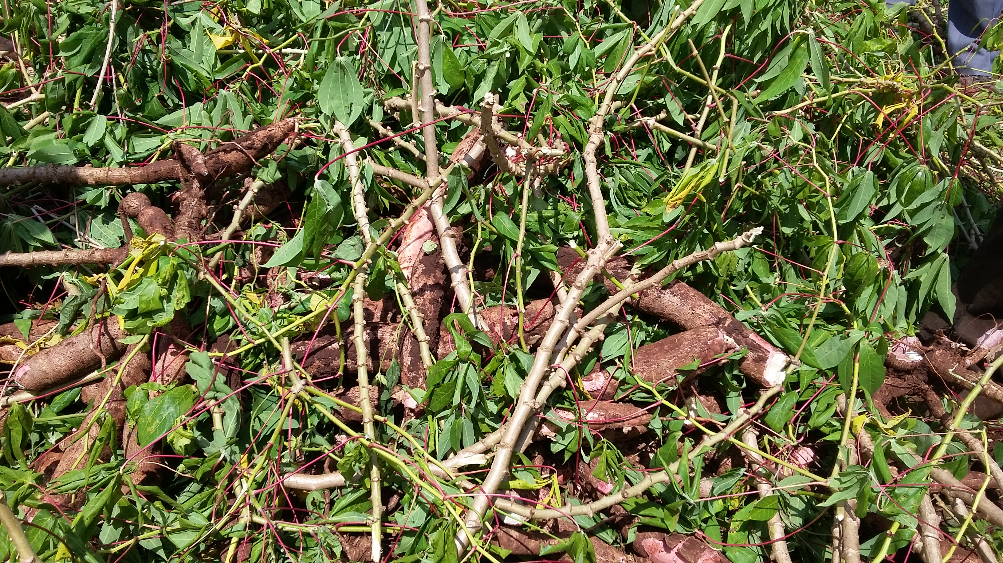
Results continued
Rural assembler :
occur where buyer fails to show up
losses up to 50 - 80% when they occur
Very rare tho
mitigation measurers:
quickness in activity
Timing – done in afternoon
Covers the roots with leaves
Leaves the soil on roots

Slide 9
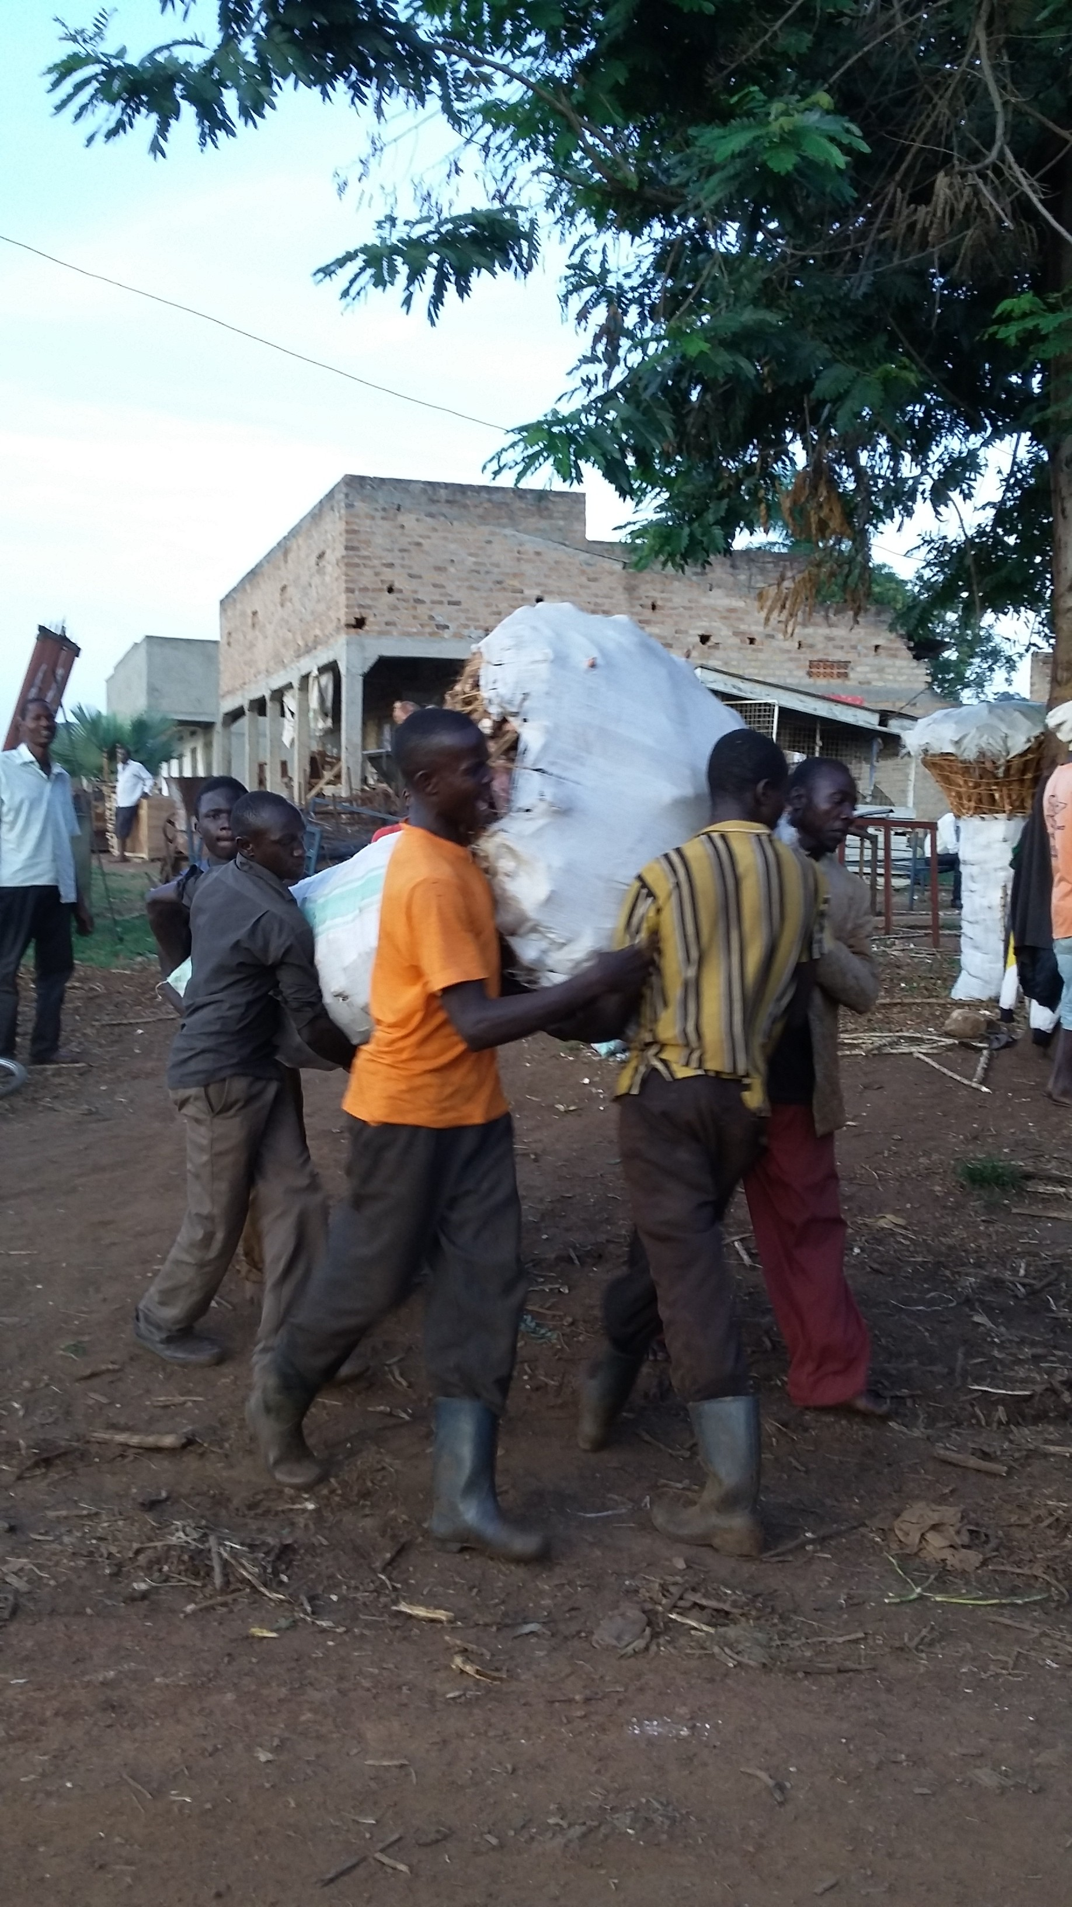
Results continued
Rural assembler :
payment after packaging and loading
Quickly transfers to wholesaler

Slide 10
Results wholesaler
wholesaler level :
usually orders
losses up to 50 - 80% when they occur
Very rare

Slide 11
Results retail
retail level :
highest burden
losses both ( physical and econ)
Econ higher ( btn 90 % - 95%)
Response to avoid
less volumes over time (experience) only buys what can sell
Try to create shade
Soak unsold
Reduce price ( day 2 price reduces by btn 40 – 60%)

Slide 12
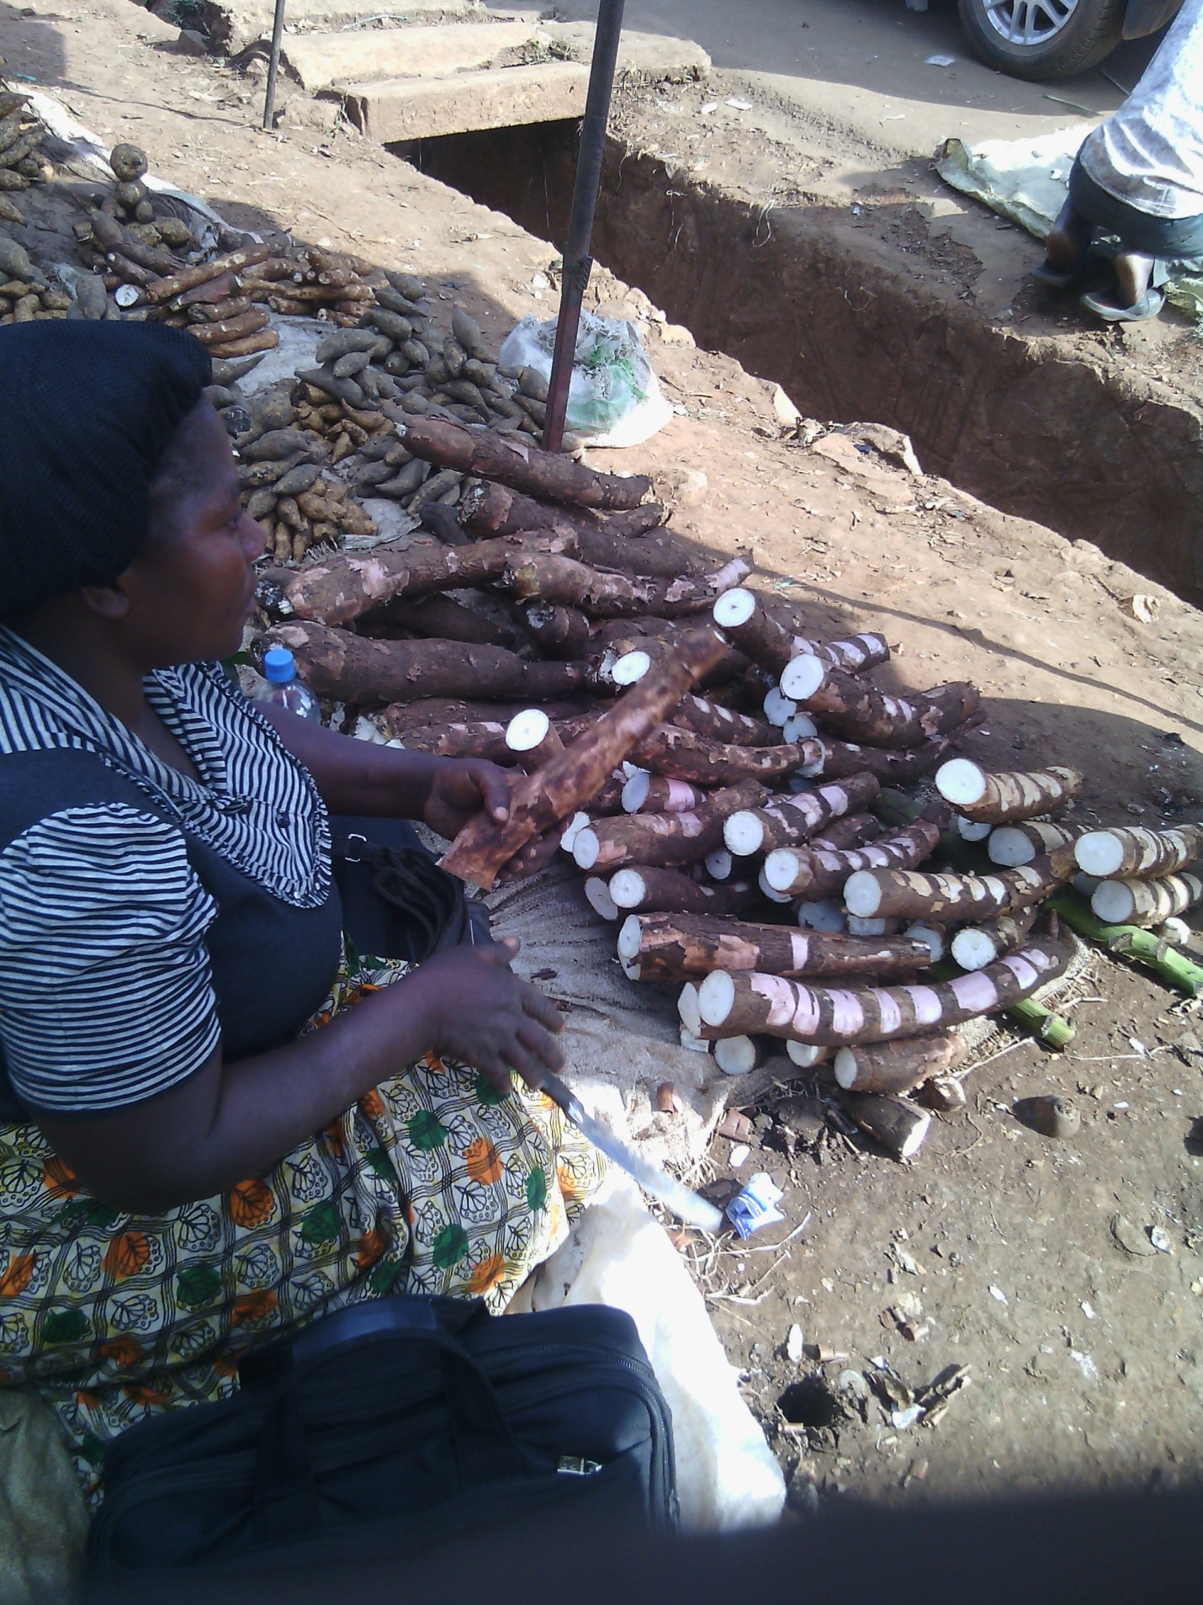
Results retail cont....
retail level :
continous cutting off edges to show fresh ness Vs loss
Hence physical loss sets in fast
Accelerated economic loss due to injury

Slide 13
Our dream
More fresh cassava with longer shelf-life on shelves
Appreciation :
IFAD
EU
CIP
Thank You

