Slide 1
The Use of Sweet Potato Residues as Feed in Rural and Peri-urban Smallholder Pig Systems in Uganda
D. Pezo , E.A. Ouma, M. Dione, P. Lule, B. Lukuyu,
N. Carter and G. Kyalo
Meeting of the Community of Practice (CoP) on Sweet potato Marketing, Processing and Utilization
Nairobi, May 20 -21, 2015
Notes:
There MUST be a CGIAR logo or a CRP logo. You can copy and paste the logo you need from the final slide of this presentation. Then you can delete that final slide
To replace a photo above, copy and paste this link in your browser: http://www.flickr.com/photos/ilri/sets/72157632057087650/detail/
Find a photo you like and the right size, copy and paste it in the block above.

Slide 2
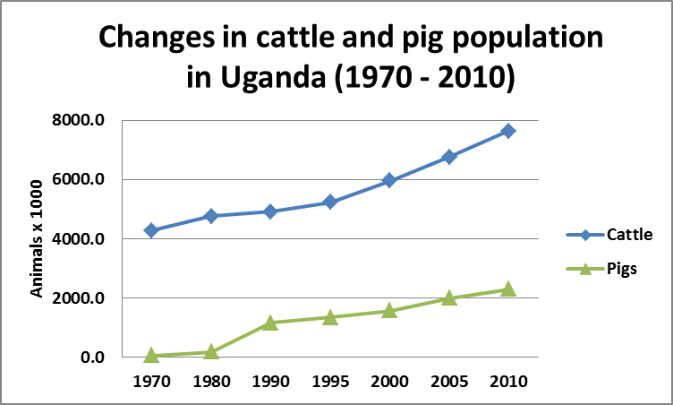
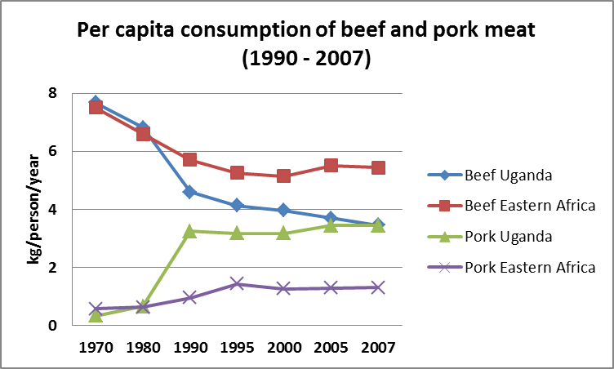
Importance of Pig Production in Uganda
Pig production- a dynamic and rapidly growing sector in Uganda. In the past three decades increased from 0.19 to 3.2 million pigs (UBOS, 2009; FAO, 2011).
Uganda has the highest per capita consumption (3.4 kg/person/year) in the region -10 times increase in the last 30 years, whereas beef is declining (FAO, 2011)

Slide 3
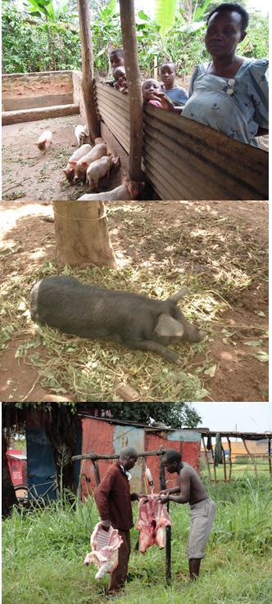
The pig sector in Uganda is largely informal
Mostly a backyard activity, managed by women and children, as means to diversify risk and increase livelihood security.
Uncoordinated trade & transport
Mostly unsupervised slaughter, no meat inspection in local markets, road-side butchers
Pork joints
Involves >1.1 million households.
Tethering & scavenging dominant in rural settings and housed animals more relevant in peri-urban systems.
Poor knowledge on disease control and biosecurity measures

Slide 4
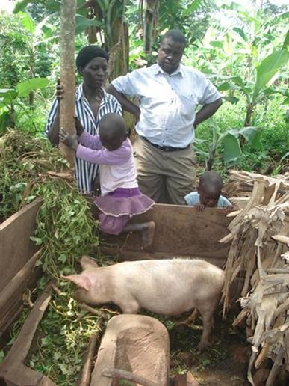
Pig Feeding in Uganda: Constraints and Opportunities
Feeding 60-75% of total variable costs.
Crop residues, forages and kitchen leftovers represent 70-75% of the diet along the year. Grasses and weeds replace crop residues during crop growing periods and dry season.
Feed collection and feeding mainly done by women and children, however men and few hired labor participate more in peri-urban settings.
Main constraints as identified by farmers: fodder shortages in the dry season, high cost of commercial feeds, price fluctuations of feed ingredients and poor quality of purchased feeds
Sweet potato vines the most preferred fodder for pigs, regardless of VC domain; cassava leaves the 2nd most preferred in rural, while yam leaves in peri-urban settings.
Pezo et al, 2014

Slide 5
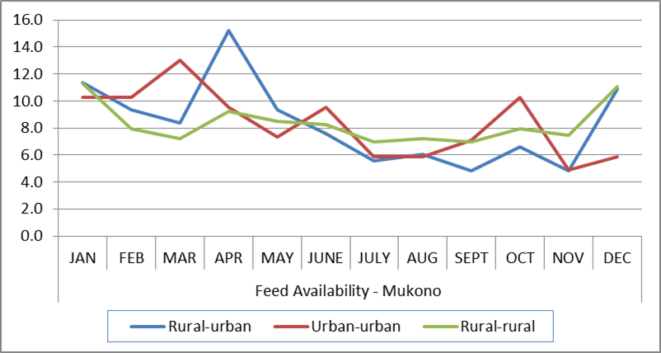
Feeding Strategies - Seasonality
Relative availability of feeds along the year in smallholder
pig farms in Mukono
Ouma et al, 2014

Slide 6
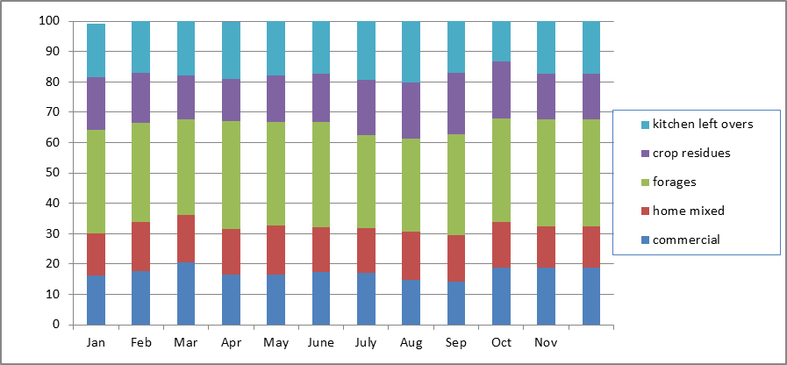
Feeding Strategies - Diversity
Types of feeds used in different periods of the year in Kamuli
Ouma et al, 2014

Slide 7
Use of fodder sources in smallholder pig systems in Uganda, as a function of VC domain
Pezo, 2015

Slide 8
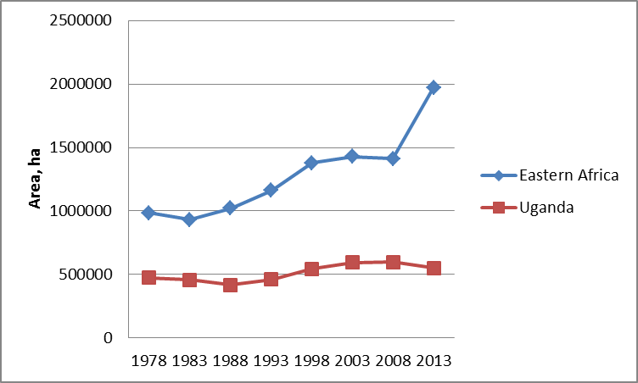
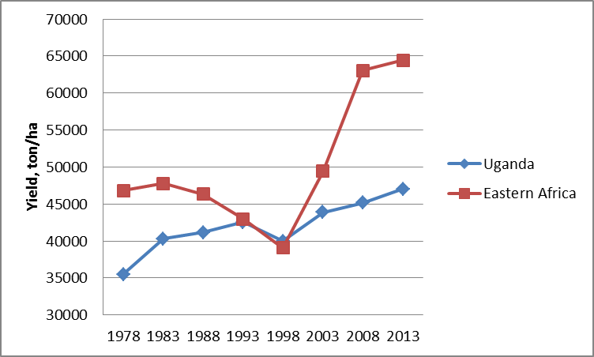
Importance of Sweet Potatoes in Uganda and
Eastern Africa
Uganda is the 2nd largest producer of sweet potatoes in the world, only after China
The area planted with SP has not changed much in the last 35 years in Uganda but there were significant increases in productivity (FAO, 2014)

Slide 9
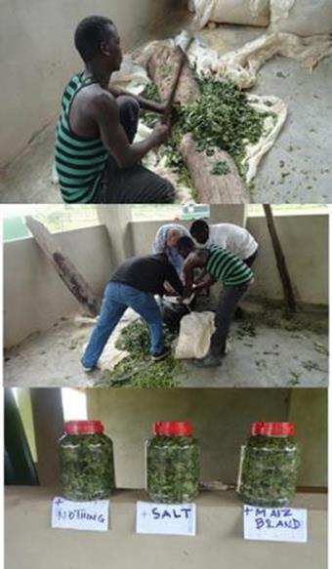
Sweet potato residues: a viable option for improving pig feeding at low cost
Sweet potato (SP) is a widely grown crop and a good source of energy (roots) and protein (vines), but highly perishable.
Feed conservation strategies will help to reduce wastage of SP residues, and extent their use in periods of feed scarcity.
Simple silage making technologies and strategic supplementation are easy and affordable options for conservation of SP roots and vines; but, new options need to be assessed and shared with farmers.

Slide 10
LWG (g day⁻¹) in local and crossbred pigs fed on concentrates, SP silage- and fresh local feeds-based diets ¹
ª Pigs weighing > ±20 kg at beginning of the trial
¹ Results have been shared with female and male farmers in Masaka, to assess
acceptability of these technology innovations.
Carter et al, unpubilshed data

Slide 11
LWG, FCR and economic benefits in pigs fed on farmers’ diets or SP silage-based diets + supplements in Sichuan, China
Diet | Initial weight, kg | LW gain, g day ⁻¹ | Feed Conversion kg kg ⁻¹ | Economic benefit increase, %
Farmers’ Control | 41.0 | 438 | 4.86 | -----
Protein-rich concentrate | 40.9 | 624 | 3.44 | + 33
Premix (amino acids and vitamins | 41.1 | 662 | 3.22 | + 78
Pezo et al, 2004

Slide 12
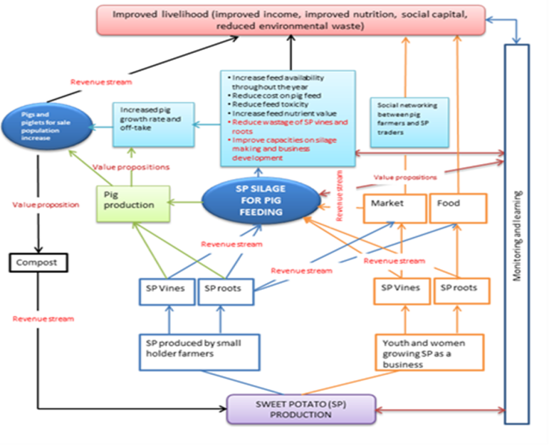
A business model promoted under RTB-ENDURE, by ILRI, CIP and partners in Uganda

Slide 13
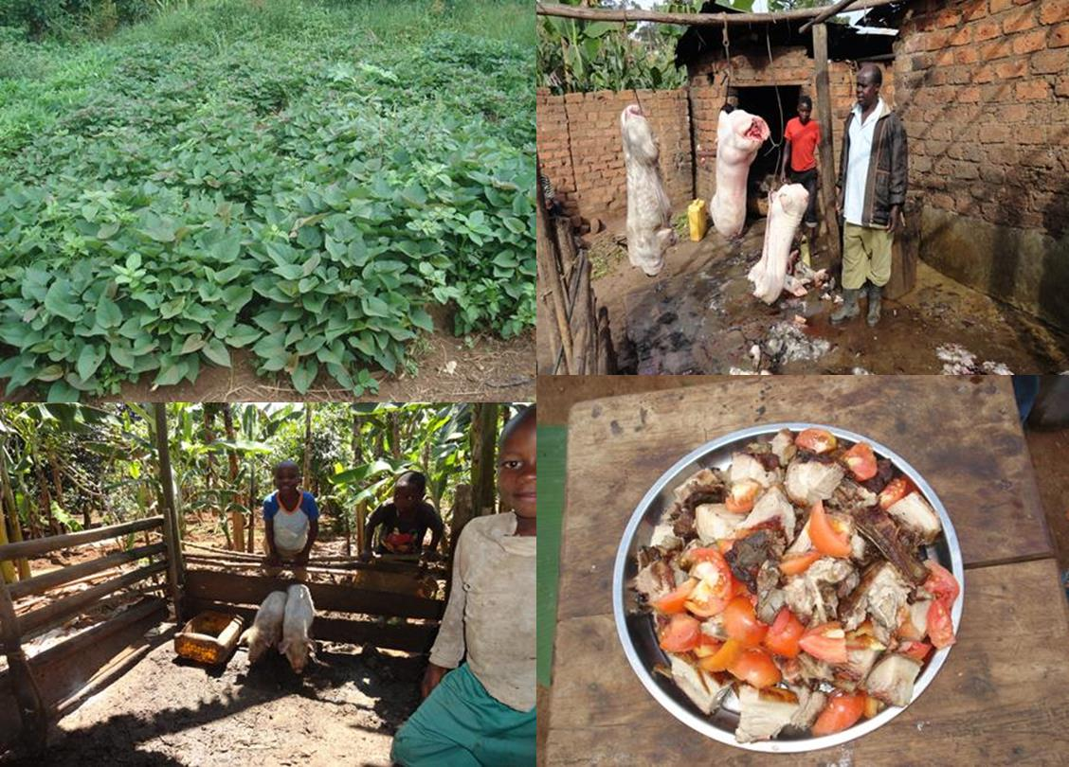
CONCLUSION
The use of sweet potato silage as pig feed results in significant increases in live weight gain and a reduction in feeding costs by partial replacement of commercial concentrates; therefore could contribute to improve the livelihoods of poor households that raise pigs and grow sweet potatoes.

Slide 14
